Slide 1
Sentiment Around COVID-19 Media Exposure
Ronald W Buie

Slide 2
Background: Epidemology and Communication
SARS-CoV-2 is an emergent disease that rapidly achieved pandemic status
Airborne and Highly Communicable
Most infected are not diseased but at least many of them are infectious
Control of outbreaks requires behavior change
Messaging must be done well

Slide 3
Twitter Usage
Twitter is a major communications platform utilized by 27% of Americans. This far reach prompts significant use by media outlets.
Over half of all journalist microblog, citing Twitter as their primary platform
About 12% of Americans use twitter for news
Facebook (43%) and Youtube (21%), while more popular, are less studyable

Slide 4
Sentiment Analysis
Sentiment analysis is a family of approaches to quantify characteristics of meaning and attitude in human communication. Dictionary based sentiment analysis uses a dictionary of word-sentiment pairs to assign scores to words used in a communication.
Capture non-syntactic characteristics of language, such as emotional states
Amenable to high-throughput analysis
Are domain specific and inherently biased

Slide 5
Research Question
Exploration of the relationship between sentiment and media messaging may provide insight into how people respond to messaging from different sources and motivate further research.
This study uses cluster analysis to explore relationship between the sentiments and news source among those who reply to COVID-19 related tweets.

Slide 6
Method: Twitter Data
US tweets classified as “news” that included the hashtag “covid19” (N 3998), and their replies (N 895) were retrieved through the Twitter API. For news sources, we identified the news source by the url referenced.
The text of each reply tweet was given a sentiment score using the tidytext implementation of F. Nielsen’s twitter sentiment dictionary. Prior to scoring, text were cleaned for for non-word characters. Because it appears often, and is part of the AFINN dictionary, the word “trump” was removed from scoring.

Slide 7
Method: Analysis
In order to optimize information available from our data, we calculate a dissimilarity matrix using the approach of Kaufman and Rousseeuw implemented in the R cluster::daisy function. Their approach includes implementation of a dissimilarity measure proposed by Gower (1964) capable of representing various data type.

Slide 8

Method: Analysis
The model is specified as:
$$d_{ij}=d(i,j)=\frac{\sum_{k=1}^{p}{w_{k}}δ_{ij}^{(k)}d_{ij}^{(k)}}{\sum_{k=1}^{p}{w_{k}}δ_{ij}^{k}}$$
Where, for dissimilarity $d$ for observations $i$ & $j$, $p$ variables and $w$ as an optional weighting variable, $δ$ as an indicator of missingness, where it is 0 when either variable is missing, and $d$ is our indication of similarity.
Using this approach, our form of $d_{ij}^{(f)}$ varies for each variable type, but always takes a value between 0 and 1 inclusive.
Heirarchical clustering was then applied to the matrix to explore classification.

Slide 9
Methods: Analysis
variable type | response description
nominal | 1 if match, else 0
binary | 1 if match, else 0
ordinal | stndzd difference
continuous | stndzd difference

Slide 10
Results: Data
Variable | description | Presence
tweet id | unique id of tweet | N 878
lms | 3 level indicator of length | M1.2, min 0, max 2
sent | 4 level indicator of sentiment | M-0.8, min -15, max 9
source | root source of news | 129 (unique)

Slide 11
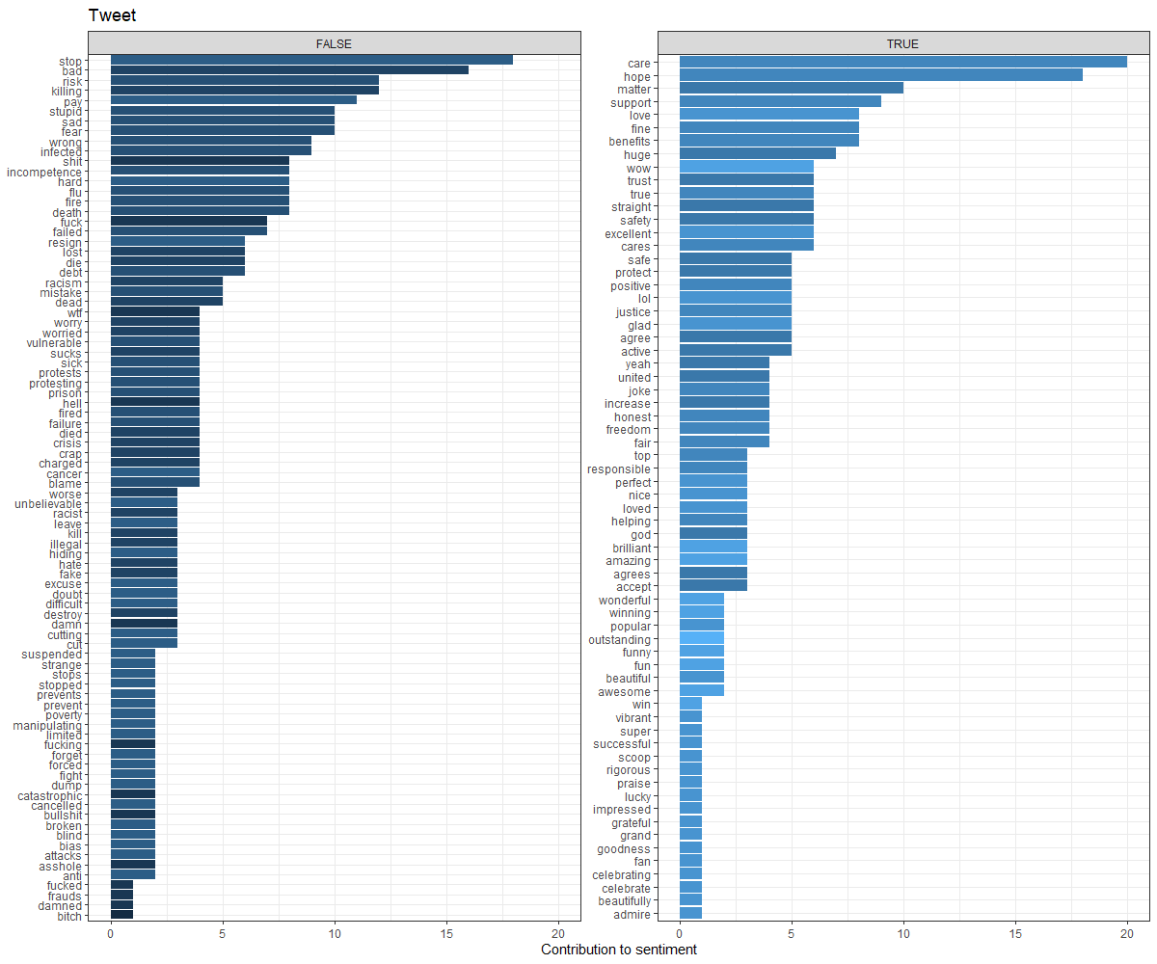
Results: Sentiment

Slide 12
Results: Mean Across Groups
mean_sent | mean_char | org_count | mess_count | Kmax
-0.6266867 | 128.18591 | 111 | 667 | K2
-1.4230769 | 139.74519 | 18 | 208 | K2
-0.6266867 | 128.18591 | 111 | 667 | K3
-1.2651515 | 111.81818 | 1 | 132 | K3
-1.6973684 | 188.25000 | 17 | 76 | K3
0.6417910 | 60.83582 | 19 | 67 | K4
-0.7683333 | 135.70667 | 92 | 600 | K4
-1.2651515 | 111.81818 | 1 | 132 | K4
-1.6973684 | 188.25000 | 17 | 76 | K4
0.6417910 | 60.83582 | 19 | 67 | K5
-0.7683333 | 135.70667 | 92 | 600 | K5
-1.2651515 | 111.81818 | 1 | 132 | K5
-1.5818182 | 202.87273 | 16 | 55 | K5
-2.0000000 | 149.95238 | 1 | 21 | K5
0.6417910 | 60.83582 | 19 | 67 | K6
-0.2484848 | 158.26667 | 37 | 165 | K6
-0.9655172 | 127.14943 | 55 | 435 | K6
-1.2651515 | 111.81818 | 1 | 132 | K6
-1.5818182 | 202.87273 | 16 | 55 | K6
-2.0000000 | 149.95238 | 1 | 21 | K6
Clusters generated using “complete” clustering

Slide 13
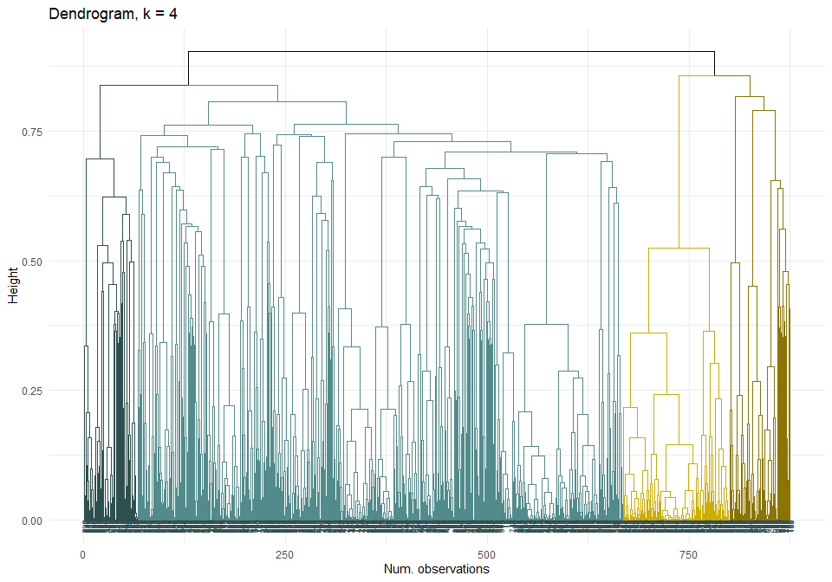
Results: Dendrogram

Slide 14
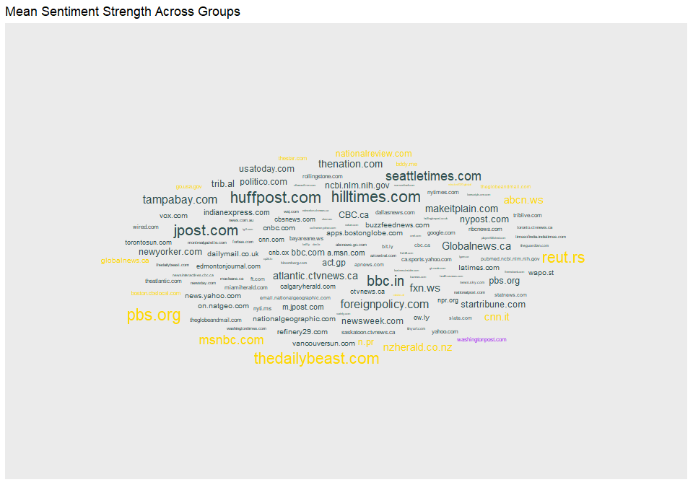
Results: Sentiment K3

Slide 15
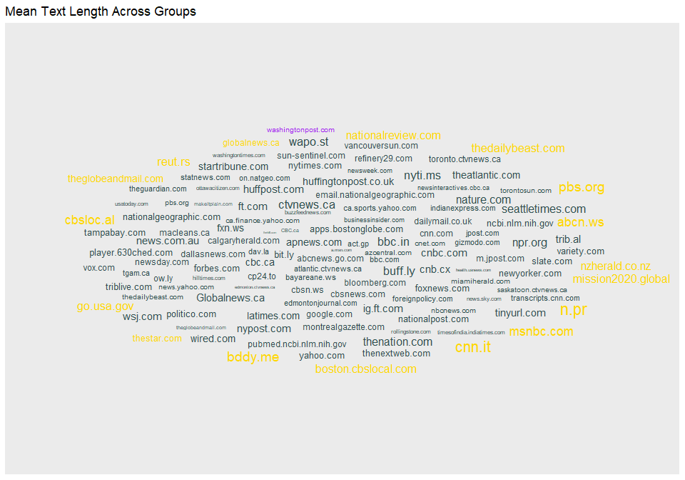
Results: Length K3

Slide 16
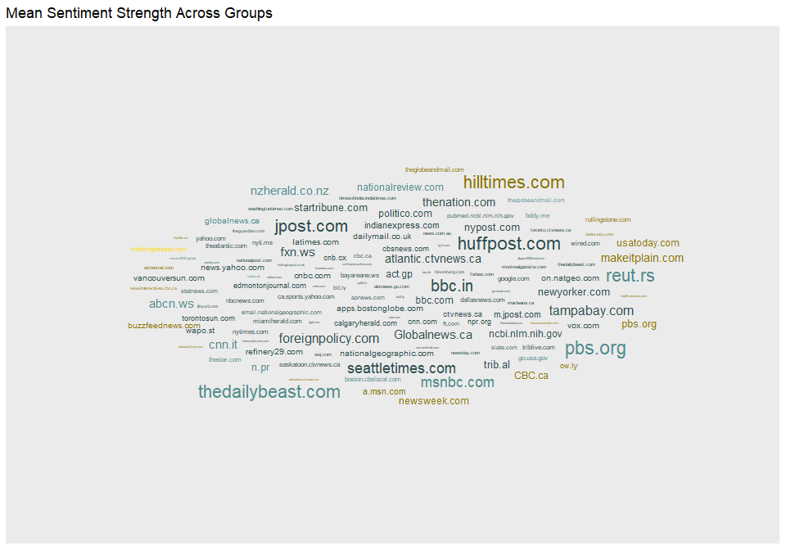
Results: Sentiment K4

Slide 17
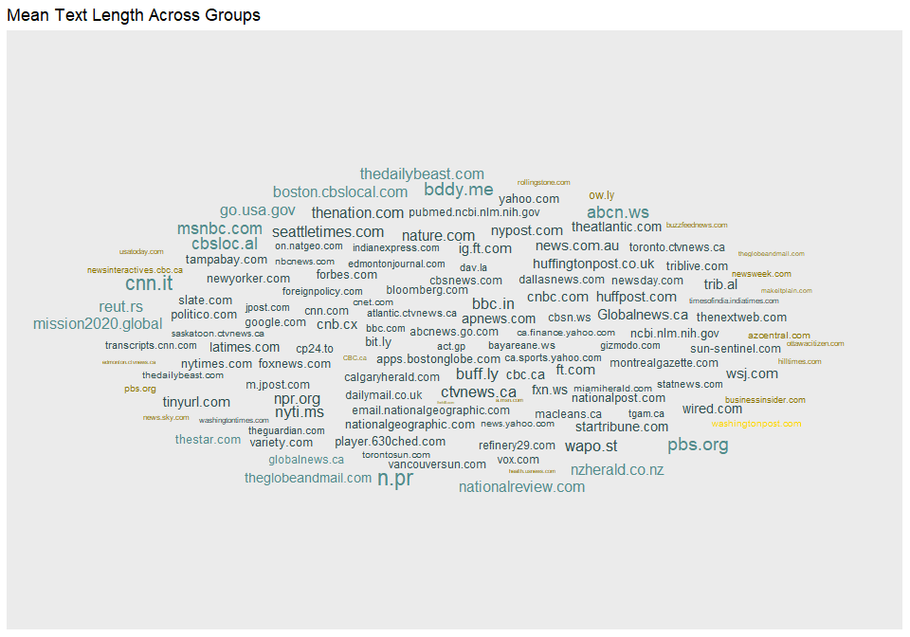
Results: Length K4

Slide 18
Conclusions
Our gray cluster has a higher proportion of low sentiment and highest sentiment, with the gold cluster being moderate
The darker gray cluster has stronger sentiments than the lighter gray cluster
mean length seems scattered similarly across groups
2 or three clusters appears to capture

Slide 19
Limitations
The use of an off-the-shelf word-dictionary is likely a poor fit for our sentiment
The lack of information about news sources, and didactic content of messages suggest this is not likely to be a good description
Twitter data are not clean or necessarily representative of population level behavior. It is unlikely to be reflective of national or regional responses.

Slide 20
Questions?
buierw@uw.edu
https://github.com/rwbuie/twitter_sentiment

